Slide 1
Industry Training on Final Rule April 11th 2019 Webinar

Slide 2
Introduction
What does this Webinar cover?
This Webinar is a walkthrough of the changes made to the HERMIT system to accommodate the Final Rule requirements
What does this Webinar not cover?
This Webinar does not cover any HUD policy related items
What is the audience for this Webinar?
Approved HERMIT System Users that service HECM Loans

Slide 3
HERMIT System Changes Related to Final Rule
 | Title | HERMIT System Change Description | Reference
#1 | Stop MIP Collection | For FHA Case # Assigned Date on or after 9/19/17, the collection of MIP will stop when completion dates are entered in HERMIT for the following steps: Foreclosure Sale, Deed-in-Lieu, or Short Sale. | CFR section 206.103 Payment of MIP (c) Acquisition of Title. Page 7132.
#2 | Debenture Interest on Claim Type 23 (Short Sale) | For FHA Case # Assigned Date on or after 9/19/17, CT 23 (Short Sales) that are not Due and Payable, Note Interest will be paid up to the Deed Recorded Date and Debenture Interest paid thereafter (except when curtailed). For FHA Case # Assigned Date on or after 9/19/17, For CT 23 (Short Sales) that are in Due and Payable, Note Interest will continue to be paid up to the Due Date, followed by Debenture Interest (except when curtailed). For FHA Case # Assigned Date before 9/19/17, CT 23 (Short Sales) Note Interest will be paid up to the Deed Recorded Date and Debenture Interest paid thereafter (except when curtailed). Block #17 was changed to Deed Recorded Date in Release 5.5 on 4/7/18. Claim Expenses on Claim Type 23 Short Sale | CFR reference 206.129 Payment of claim (f) Amount of Payment – mortgagee acquires title or is unsuccessful bidder. Page 7136.
#3 | Closing Costs cannot exceed 11% of Sale Price | For FHA Case # Assigned Date on or after 9/19/17, Closing costs cannot exceed 11% of the Sales Price for Claim Type 21 Sales Based Claim (SBC) and Claim type 23. | CFR reference 206.125 Acquisition and Sale of the Property. Page 7135.
#4 | Cap Claim amount at MCA | For FHA Case # Assigned Date on or after 9/19/17, The Maximum Claim Amount PAID on an endorsed loan cannot exceed the Maximum Claim Amount (MCA). | CFR reference 206.129 Payment of claim (b) Limit on Claim Amount. Page 7136.
#5 | Limit 2/3 Payment on Specified Property Charges | For FHA Case # Assigned Date on or after 9/19/17, HERMIT will limit specified SECTION 305 transaction codes to 2/3’s of the full transaction amount. | CFR reference 206.129 Payment of claim (d) Amount of Payment – Mortgagee acquires title or is unsuccessful bidder. Page 7136

Slide 4
HERMIT System Changes as it relates to Final Rule
 | Title | HERMIT System Change Description | Reference
#6 | New Loan Transaction Codes | New Transaction Code added to HERMIT for 1) “Corp Adv – S305 Utilities – Liens” and 2) “ Corp Adv – S305 – Cash for Keys”. | CFR reference 206.129 Payment of claim (d) Amount of Payment – Mortgagee acquires title or is unsuccessful bidder. Acquisition and Sale of the Property (f) Deed in Lieu of Foreclosure (ii) Cash for Keys. Page 7136.
#7 | Due Date Changes to IMIP and MMIP | For All Loans: Initial MIP: Late Charge and Penalty Interest on Initial MIP paid more than 20 days from closing. Monthly MIP: Late Charge and Penalty Interest on Monthly MIP paid more than 6 days from the first business day of the month. | CFR section § 206.113 Late Charge and interest. Page 7133.
#8 | Auto-Curtailment | Notification to HUD of Default for D&P with HUD Approval must be within 30 days of Default. | Mortgagee Letter 2015-10 and CFR Reference § 206.125(a)(1).
#9 | Auto-Curtailment | Notification to HUD of Default for D&P w/o HUD Approval must be within 60 days of Death (without death extension). | Mortgagee Letter 2015-10 and CFR Reference § 206.125(a)(1).
#10 | Auto-Curtailment | Notification to HUD of Default for D&P w/o HUD Approval must be within 30 days of Extension – Late Notification of Death “Extension Expiration Date”. | Mortgagee Letter 2015-10 and CFR Reference § 206.125(a)(1).

Slide 5
HERMIT System Changes as it relates to Final Rule
 | Title | HERMIT System Change Description | Reference
#11 | Auto-Curtailment | Notification to HUD of Default for D&P w/o HUD Approval must be within 60 days of Conveyed Title Default Date. | Mortgagee Letter 2015-10 and CFR Reference § 206.125(a)(1).
#12 | Auto-Curtailment | Notification to Borrower of Due & Payable for D&P with HUD Approval – Must Notify Borrower no later than 30 days from HUD Decision Approved D&P. | Mortgagee Letter 2015-10 and CFR Reference § 206.125(a)(2).
#13 | Auto-Curtailment | Notification to Borrower of Due & Payable for D&P w/o HUD Approval – Must Notify Borrower no later than 30 days from Notification to HUD of D&P. | Mortgagee Letter 2015-10 and CFR Reference § 206.125(a)(2).
#14 | Auto-Curtailment | First Legal Curtailment for D&P with HUD Approval and FHA Case # Assigned Date before 9/19/17. | Mortgagee Letter 2015-10 and CFR Reference § 206.125(d)(1).
#15 | Auto-Curtailment | First Legal Curtailment for D&P w/o HUD Approval: Death and FHA Case # Assigned Date before 9/19/17. | Mortgagee Letter 2015-10 and CFR Reference § 206.125(d)(1).

Slide 6
HERMIT System Changes as it relates to Final Rule
 | Title | HERMIT System Change Description | Reference
#16 | Auto-Curtailment | First Legal Curtailment for D&P w/o HUD Approval: Conveyed Title and FHA Case # Assigned Date before 9/19/17. | Mortgagee Letter 2015-10 and CFR Reference § 206.125(d)(1).
#17 | Auto-Curtailment | First Legal Curtailment for D&P with or w/o HUD Approval and FHA Case # Assigned Date on or after 9/19/17, the initiation of FCL (First Legal) or a Deed in Lieu (DIL) must be completed within 6 months of the DUE DATE. | Mortgagee Letter 2015-10 and CFR Reference § 206.125(d)(1).
#18 | Auto-Curtailment | Notify HUD of First Legal with a D&P DUE DATE on or after 7/1/15 (Effective Date of ML 2015-10), HUD must be notified of First Legal Date within 30 days. | Mortgagee Letter 2015-10 and CFR Reference § 206.125(d)(1).
#19 | Auto-Curtailment | Foreclosure Sale Appraisal must be completed 30 days prior to “Foreclosure Sale” date for FHA Case # Assigned Date on or after 9/19/17. | Mortgagee Letter 2015-10 and CFR Reference § 206.125(b).
#20 | Auto-Curtailment | For FHA Case # Assigned Date on or after 9/19/17, change number of days for Claim Filing Deadline from 15 days to 30 days. | CFR section § 206.127 Application for Insurance Benefits. Page 7136.

Slide 7
FHA Case # Assigned Date field
“FHA Case # Assigned Date” for each loan is used to determine whether final rule logic applies. The field is found on Loan > Loan Details screen, in the Loan Rates section:
If the date is Blank, the FHA Case # Assigned Date is considered to be before 9/19/17.

Slide 8
#1 - Stop MIP Collection – Overview
For FHA Case # Assigned Date on or after 9/19/17 (Effective Date of the Final Rule), the collection of Monthly MIP on Endorsed Loans will stop for the following reasons:
Foreclosure Sale Held – Foreclosure Sale Date step Completed
Deed in Lieu is Recorded – Deed Recorded Date step Completed
Short Sale Closed – Sale Closing Date step Completed
Servicing Type / Timeline | Step Complete Date that stops MIP collection
Foreclosure | Foreclosure Sale Date
Loss Mitigation - Deed in Lieu | Deed Recorded Date
Loss Mitigation - Short Sale | Sale Closing Date
CFR Reference: CFR section 206.103 Payment of MIP (c) Acquisition of Title. (Page 7132)

Slide 9
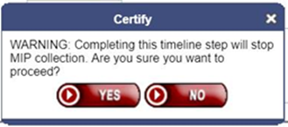
#1 - Stop MIP Collection (continued)
Stop MIP Collection after Foreclosure Sale is Completed
HERMIT step named Foreclosure Sale Date on the Foreclosure timeline is used to notify HUD of completion of Foreclosure Sale.
For FHA Case # Assigned Date on or after 9/19/17, HERMIT stops accruing Monthly MIP once a Completion Date is entered in the Foreclosure Sale Date step.
NOTE: A “Certify” message box will confirm action when completing this step.
Example: The example below indicates Monthly MIP will stop accruing for this loan on 10/23/2018.
CFR Reference: CFR section 206.103 Payment of MIP (c) Acquisition of Title. (Page 7132)

Slide 10
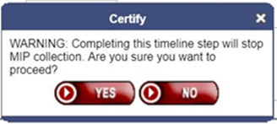
#1 - Stop MIP Collection (continued)
Stop MIP Collection after Deed Recorded step is Completed
New HERMIT step added named Deed Recorded Date to the Loss Mitigation – Deed-in-Lieu timeline.
For FHA Case # Assigned Date on or after 9/19/17, HERMIT stops accruing Monthly MIP once a Completion Date is entered on the Deed Recorded Date step.
NOTE: A “Certify” message box will confirm action when completing this step.
Example: The example below indicates Monthly MIP will stop accruing for this loan on 12/19/2017.
CFR Reference: CFR section 206.103 Payment of MIP (c) Acquisition of Title. (Page 7132)

Slide 11
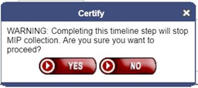
#1 - Stop MIP Collection (continued)
New HERMIT step added named Sale Closing Date to the Loss Mitigation – Short Sale timeline.
For FHA Case # Assigned Date on or after 9/19/17, HERMIT stops accruing Monthly MIP once a Completion Date is entered on the Sale Closing Date step.
NOTE: A “Certify” message box will confirm action when completing this step.
Example: The example below indicates Monthly MIP stops accruing for this loan on 01/30/2019.
Stop MIP Collection after Sale Closing is Completed
CFR Reference: CFR section 206.103 Payment of MIP (c) Acquisition of Title. (Page 7132)

Slide 12
#1 - Stop MIP Collection (continued)
Additional Information when MIP is stopped due to completing one of the previously discussed 3 timeline steps.
A New Alert Type is added to the loan record named MIP Collection Stopped – [specified] Step Date.
A New Auto-Note is added to the loan record labeled MIP collection stopped due to [specified] Step Completion Date.
Alert and Auto-note will both be added to the loan when the user clicks “Yes” to add the Step Complete Date to the timeline which causes MIP to be stopped on the loan.
CFR Reference: CFR section 206.103 Payment of MIP (c) Acquisition of Title. (Page 7132)

Slide 13
#1 Stop MIP Collection (continued)
MIP Collection restarts after INACTIVATING Timeline:
MIP collection will restart if the corresponding Timeline Status is changed to INACTIVE when MIP was previously stopped due to a Step Completion Date.
Applicable Late Charge and Penalty Interest will be charged on the generated MIP adjustment transactions due to changing the Timeline Status to INACTIVE.
After the Timeline Status is changed to INACTIVE, the MIP Collection Stopped alert will be updated to INACTIVE.
NOTE: These timelines cannot be changed back to ACTIVE after INACTIVATING
Example: The MIP Collection Stopped Alert Status changes to “Inactive” as indicated below.
CFR Reference: CFR section 206.103 Payment of MIP (c) Acquisition of Title. (Page 7132)

Slide 14
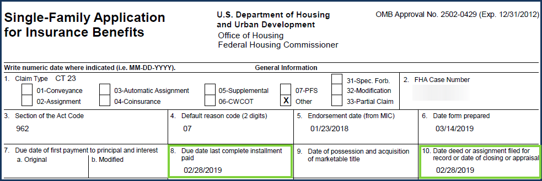
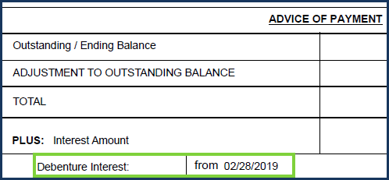
#2 - DBI on Short Sale (when not D&P)
Debenture Interest (DBI) on Claim Type 23 Short Sale – when NOT Due & Payable
For FHA Case # Assigned Date on or after 9/19/17 AND for CLAIM TYPE 23 ONLY, the DBI Effective Date is as follows:
If the loan is NOT Due & Payable, then Block #8 and Block #10 are both equal to the Deed Recorded Date step Complete Date from the Loss Mitigation – Short Sale timeline.
Block #17 includes Note Interest up to Block #10 and DBI from Block #10 to Settlement Date or Curtailment Date (if applicable).
Example: CT23 was NOT D&P therefore Block #8 and Block #10 are equal and DBI is effective/starts from Block #10.
CFR Reference: 206.129 Payment of claim (f) Amount of Payment – Mortgagee acquires title or is unsuccessful bidder. (Page 7136)

Slide 15
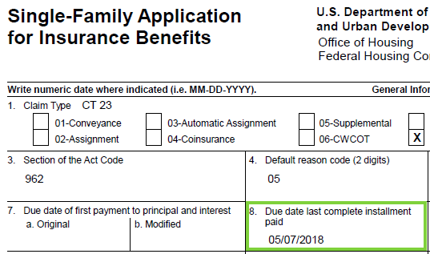
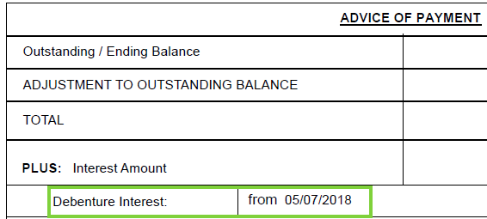
#2 - DBI on Short Sale (when D&P)
Debenture Interest (DBI) on Claim Type 23 Short Sale – when Due and Payable
For FHA Case # Assigned Date on or after 9/19/17 AND for CLAIM TYPE 23 ONLY, the DBI Effective Date is as follows:
If loan is Due & Payable, then Block #8 = “Due Date” and Block #10 = Deed Recorded Date step Complete Date from the Loss Mitigation – Short Sale timeline. (NEW HERMIT step in release v5.4)
Block #17 includes Note Interest up to Block #8 and DBI from Block #8 to Settlement Date or Curtailment Date (if applicable).
Example: the DUE Date is 5/7/2018 and the DBI Effective Date is also 5/7/2018.
CFR Reference206.129 Payment of claim (f) Amount of Payment – Mortgagee acquires title or is unsuccessful bidder. (Page 7136)

Slide 16
#2 - DBI on Short Sale (continued)
Debenture Interest (DBI) on Claim Type 23 Short Sale – Case Numbers assigned before 9/19/17
For FHA Case # Assigned Date before 9/19/17 AND CLAIM TYPE 23 ONLY, the DBI Effective Date is calculated from the Deed Recorded Date + 1 day.
The same DBI Effective Date is used regardless of whether the loan is D&P or not D&P.
Block #10 = Deed Recorded Date step Complete Date from the Loss Mitigation – Short Sale timeline.
Block #17 includes Note Interest up to and including Block #10 and DBI from Block #10 plus one day to Settlement Date or Curtailment Date (if applicable).
Example: The case number was assigned before 9/19/17, therefore DBI starts 1 Day from the Deed Recorded Date step Complete Date.
CFR Reference: 206.129 Payment of claim (f) Amount of Payment – Mortgagee acquires title or is unsuccessful bidder. (Page 7136)

Slide 17
#2 – Claim Expenses on Short Sale
Claim Expenses on Claim Type 23 Short Sale
For CLAIM TYPE 23 with D&P ONLY, Claim Expenses will be included through the Deed Recorded Date step Complete Date instead of the previous Sale Closing Date step on the Loss Mitigation – Short Sale timeline.
For FHA Case # Assigned Date before 9/19/17 AND for CLAIM TYPE 23 with D&P ONLY, Block #17 (UPB at D&P) is through the Block #10 Deed Recorded Date step Complete Date. Claim Expenses continue to be included on the claim through the Deed Recorded Date.
NOTE: Do not adjust off Corp Advances if they were incurred or effective prior to the Deed Recorded Date and attempt to enter them as Loan Balance transactions. Corp Advance Expenses and DBI on expenses are still paid between Block #8 and Block #10 as they are not included in the Loan Balance Block #17.
CFR Reference: 206.129 Payment of claim (f) Amount of Payment – Mortgagee acquires title or is unsuccessful bidder. (Page 7136)

Slide 18
#3 - Closing Costs Cannot Exceed 11% of Sales Price
Closing Costs cannot Exceed 11%
For FHA Case # Assigned Date on or after 9/19/17, Closing Costs cannot exceed 11% of the Sales Price from the Claims Disposition Screen. (NOTE: The FHA Case # Assigned Date restriction logic was implemented in v5.41)
The 11% Closing Cost cap is cumulative across multiple claims. In other words, the cumulative total of Claim Section #407 and #408 from both the parent claim and, if applicable, the CT 24 Supplemental claim, is included in the 11% Closing Cost cap validation.
Applies to Claim Type 21 Sales Based Claim (SBC), Claim Type 23 and Claim Type 24.
If the total Closing Costs in sections #407 and #408 exceed 11% of Sales Price, a hard-stop message will be displayed which reads: “Closing Costs cannot exceed 11% of Sales Price. Please adjust Section #407 and #408 transactions accordingly. Closing Costs total: $X,XX.XX. 11% of Sales Price: $X,XXX.XX. Overage: $X,XXX.XX”. (NOTE: Message provides you the Overage Amt.)
Applicable Closing Costs need to be adjusted under the “Overage Amount” before the Servicer is permitted to submit the claim. (See example message below).
CFR reference 206.125 Acquisition and Sale of the Property. (Page 7135)

Slide 19
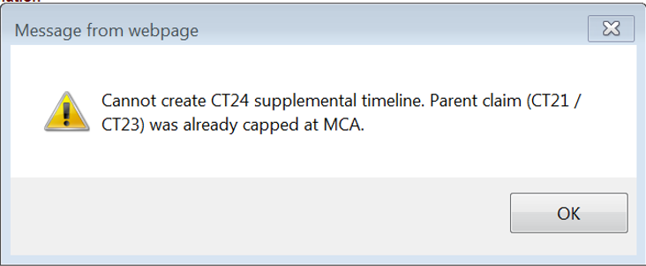
#4 - Claim Payment Cannot Exceed MCA
Total Claim Paid Cannot Exceed Maximum Claim Amount (MCA)
For FHA Case # Assigned Date on or after 9/19/17, the Maximum Claim PAID Amount on an Endorsed Loan cannot exceed the MCA.
In other words, the total of all loan amounts including UPB, expenses and DBI will “automatically” be capped at MCA.
In addition, a HERMIT user will not be able to create a Claim Type 24 timeline if the Max Claim Amount was already reached on the parent claim.
Applicable HERMIT Message states “Cannot create CT24 supplemental timeline. Parent claim (CT21 / CT23) was already capped at MCA.”
Example: The HERMIT Message box indicating that a CT24 cannot be created because MCA was reached on prior claim.
CFR reference 206.129 Payment of claim (b) Limit on Claim Amount. (Page 7136)

Slide 20
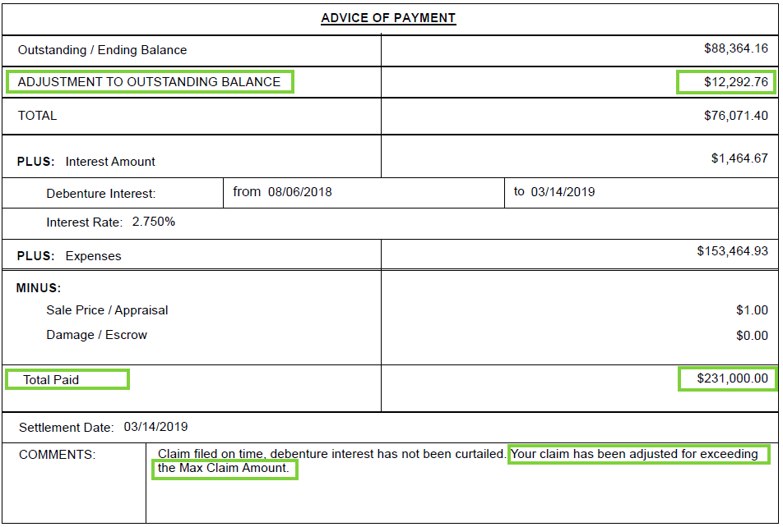
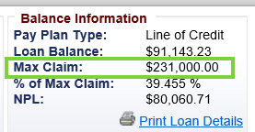
#4 - Claim Payment Cannot Exceed MCA (Continued)
Total Claim Paid Cannot Exceed Maximum Claim Amount (MCA)
The AOP field named ADJUSTMENT TO OUTSTANDING BALANCE will display any adjustment to the claim amount, including the reduction to the claim amount when the claim is capped for exceeding MCA.
AOP COMMENTS section also notates claim adjusted for exceeding MCA.
Example: Claim Paid Capped at MCA of $231,000. “Expenses” field would have caused the claim to exceed MCA.
CFR reference 206.129 Payment of claim (b) Limit on Claim Amount. (Page 7136)

Slide 21
#5 - Limit Specified Property Charges to 2/3’s of Payment
Limit Expense Amount for specified Property Charges
For FHA Case # Assigned Date on or after 9/19/17, the following Corporate Advance transaction types will pay at 2/3’s of the HERMIT transaction amount on the claim.
Applies to Claim Type 21, Claim Type 23 and Claim Type 24.
This table shows which Corporate Advance Expenses paid at FULL Amount OR paid at 2/3’s
Columns identify logic for both FHA Case # Assigned Date before 9/19/17 and FHA Case # Assigned date on or after 9/19/17.
Corporate Advance - Section 305 | Loan with FHA Case # Assigned BEFORE 9/19/17 | Loan with FHA Case # Assigned ON or AFTER 9/19/17
Corp Adv - S305 - Flood Insurance | 100% | 2/3
Corp Adv - S305 - Condominium Dues | 100% | 2/3
Corp Adv - S305 - Ground Rent | 100% | 2/3
Corp Adv - S305 - Hazard Insurance | 100% | 2/3
Corp Adv - S305 - HOA Dues | 100% | 2/3
Corp Adv - S305 - Taxes | 100% | 2/3
Corp Adv - S305 - Utilities - Liens | 2/3 | 2/3
Corp Adv - S306 - Attorney Fees | 2/3 | 100%
Corp Adv - S306 - Other | 2/3 | 100%
Corp Adv - S306 - Repayment | 2/3 | 100%
Corp Adv - S306 - Trustee Fees | 2/3 | 100%
Corp Adv - S307 - Other | 2/3 | 100%
Corp Adv - S307 - Recording Fees | 2/3 | 100%
Corp Adv - S307 - Repayment | 2/3 | 100%
Corp Adv - S307 - Sheriff Fees | 2/3 | 100%
Corp Adv - S307 - Title Examination Fees | 2/3 | 100%
Corp Adv - S310 - Bnk Attorney Fees | 2/3 | 100%
Corp Adv - S310 - Other | 2/3 | 100%
Corp Adv - S310 - Repayment | 2/3 | 100%
CFR reference: 206.129 Payment of claim (d) Amount of Payment – Mortgagee acquires title or is unsuccessful bidder. (Page 7136)

Slide 22
#6 - New HERMIT Transaction Codes
New HERMIT Corporate Advance Expense Transaction Codes
HERMIT allows NEW Transaction Codes noted below to be added to the loan balance.
NEW Transaction Code: Corp Adv – S305 Utilities – Liens
For FHA Case # Assigned Date on or after 9/19/17, New Transaction Code: Corp Adv – S305 – Cash for Keys can be used to recover a “Cash for Keys” expense. “Cash for Keys” expense is capped at $3,000.00 and only permissible when a Loan is in a “Due & Payable” sub-status condition.
Both NEW Transaction Codes can be added into HERMIT via:
HERMIT Transaction Page
B2G Upload File
Batch Servicer Transaction Page.
NOTE: The Cash for Keys transaction cannot be entered with an Incurred Date prior to the Due & Payable date and also cannot be later than 6 months from the Due & Payable date.
CFR reference: 206.129 Payment of claim (d) Amount of Payment. Acquisition and Sale of the Property (f) Deed in lieu of foreclosure
(ii) Cash for Keys. (Page 7136)

Slide 23
#7 – Payment Due Date changes to IMIP and MMIP
Late Charges and Penalty Interest changes if MIP Payment Due Dates are missed
For all FHA Case #s, the MIP collection deadline has changed effective 9/20/2017 (one day after the 5.4 HERMIT system release).
Initial MIP - Payment is now due 20 calendar days from the Closing Date (in HERMIT Loan Details screen) and a Late Charge is assessed on calendar day 21.
Initial MIP - Payment is now due 20 calendar days from the Closing Date (in HERMIT Loan Details screen) and Penalty Interest will start accruing each calendar day starting on day 21 until paid.
Monthly MIP - Payment is now due 6 calendar days from the “First Business Day of the Month”. A Late Charge is assessed if more than 6 calendar days after the “First Business Day of the Month”.
Monthly MIP - Payment is now due 6 calendar days from the “First Business Day of the Month” and Penalty Interest will start accruing each calendar day starting on “the 7th calendar day from the 1st business day” until PAID.
Monthly MIP - Transaction Adjustments - Late Charge and Penalty Interest will be collected when a transaction is backdated by more than 6 calendar days and crosses a prior month end.
CFR reference: 206.113 Late Charge and interest. (Page 7133)

Slide 24
Auto Curtailment – General Information
The remaining slides cover HERMIT auto-curtailment
General auto curtailment information
Curtailment only applies to Debenture Interest (DBI). Note Interest is not curtailed even when the curtailment date is before the start date of DBI. If the date of curtailment is before the start date of DBI, Note Interest will still be included in Block #17, and no DBI will be paid on the claim.
Each Curtailment event may have an Effective Date which depends on one of the following:
FHA Case # Assigned Date
Due & Payable Date
Death Date
Default Date
The Curtailment Message is displayed in the “HUD Comments, if any” section in Part B of the claim form and on the “Comments” section of the AOP.

Slide 25
#8 – Auto Curtailment – Notification to HUD of Default Event
Notification to HUD of Default for D&P with HUD Approval must be within 30 days of Default Event
For loans with a D&P Due Date on or after 7/1/15, (Effective Date of ML 2015-10), Notification to HUD of Default for D&P with HUD Approval must be within 30 days of Default.
HERMIT will “auto-curtail” Claim Type 21 or Claim Type 23 if “HUD is NOT notified of a default within 30 days” which translates to the HERMIT D&P with HUD Approval timeline MUST be setup/created within 30 days of the Default Date to avoid curtailment.
If curtailed for this reason, the Debenture Interest End Date will be set to the Servicing Management page’s Default Date + 30 Days.
Example: This loan will be “auto-curtailed” because the Notification Date (Create Date) is not within 30 days of the Default Date.
Reference: Mortgagee Letter 2015-10 and CFR Reference § 206.125(a)(1).

Slide 26
#9 – Auto Curtailment – Notification to HUD of Default Event
Notification to HUD of Default for D&P w/o HUD Approval must be within 60 days of Death (without a death extension)
For loans with a Death Date on or after 7/1/15, (Effective Date of ML 2015-10), Notification to HUD of Default for D&P w/o HUD Approval must be within 60 days of Death Date.
HERMIT will “auto-curtail” Claim Type 21 or Claim Type 23 if “HUD is not notified of a default within 60 days of Death Date” which translates to the HERMIT D&P w/o HUD Approval timeline must be setup/created within 60 days of the Death Date to avoid curtailment.
If curtailed for this reason, the Debenture Interest End Date will be set to the Death Date + 60 Days.
Example: This loan will be “auto-curtailed” because the Notification Date (Create Date) is not within 60 days of the Default/Death Date.
Reference: Mortgagee Letter 2015-10 and CFR Reference § 206.125(a)(1).

Slide 27
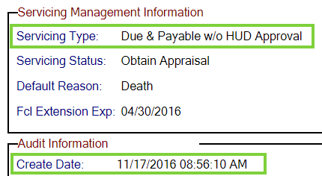
#10 - Auto Curtailment – Notification to HUD of Default Event
Notification to HUD of Default for D&P w/o HUD Approval must be within 30 days of Extension – Late Notification of Death “Extension Expiration Date”
For loans with a Death Date on or after 7/1/15, (Effective Date of ML 2015-10), Notification to HUD of Default for D&P w/o HUD Approval must be within 30 days of Death Date Extension Expiration Date.
HERMIT will “auto-curtail” Claim Type 21 or Claim Type 23 if HUD is not notified of a default within 30 days of Extension - Late Notification of Death Expiration Date which translates to the HERMIT D&P w/o HUD Approval timeline must be setup/created within 30 days of the Extension Expiration Date on the Extension – Late Notification of Death timeline to avoid curtailment.
If curtailed for this reason the Debenture Interest End Date will be set to the Extension - Late Notification of Death Expiration Date + 30 Days.
Example: This loan will be “auto-curtailed” because the Notification Date (Create Date) is NOT within 30 days of the Extension Expiration Date.
Reference: Mortgagee Letter 2015-10 and CFR Reference § 206.125(a)(1).

Slide 28
#11 – Auto Curtailment – Notification to HUD of Default Event
Notification to HUD of Default for D&P w/o HUD Approval must be within 60 days of Conveyed Title Default Date
For loans with a Conveyed Title Default Date on or after 7/1/15, (Effective Date of ML 2015-10), Notification to HUD of Default for D&P w/o HUD Approval must be within 60 days of Conveyed Title.
HERMIT will “auto-curtail” Claim Type 21 or Claim Type 23 if HUD is not notified of a default within 60 days of Default Date which translates to the HERMIT D&P w/o HUD Approval timeline must be setup/created within 60 days of the Default Date to avoid curtailment.
If curtailed for this reason the Debenture Interest End Date will be set to the Default Date + 60 Days.
Example: This loan will be “auto-curtailed” because the Notification Date (Create Date) is NOT within 60 days of the Conveyed Title Default Date.
Reference: Mortgagee Letter 2015-10 and CFR Reference § 206.125(a)(1).

Slide 29
#12 – Auto Curtailment – Notify Borrower of D&P Event
Notification to Borrower of D&P for D&P with HUD Approval must be within 30 days of HUD Approval
For loans with a D&P Due Date on or after 7/1/15, (Effective Date of ML 2015-10), Notification to Borrower of D&P must be within 30 days of HUD Approval.
For D&P with HUD Approval, HERMIT will “auto-curtail” a Claim Type 21 or Claim Type 23 if D&P Notice Sent to Borrower step is not completed within 30 days of the HUD Decision – Approved step Complete Date.
If curtailed for this reason HERMIT will set the Debenture Interest End Date to the HUD Decision - Approved step Complete Date + 30 Days.
Example: This loan will be “auto-curtailed” because the “D&P Notice Sent to Borrower” was not completed 30 days from the “HUD Decision – Approved” step.
Reference: Mortgagee Letter 2015-10 and CFR Reference § 206.125(a)(2).

Slide 30
#12 – Notify Borrower of D&P Event (Timeline Changes)
Notification to Borrower of D&P for D&P with HUD Approval (timeline step process changes)
Effective after HERMIT Release 5.71 (March 30, 2019), the step D&P Notice Sent to Borrower is auto-inserted into the D&P with HUD Approval timeline after the letter is uploaded as a document on the Upload D&P Notice Sent to Borrower timeline step.
The new sequence of steps is as follows:
Servicer submits D&P Request to HUD
HUD Approves D&P Request
Servicer uploads a copy of the letter to step Upload D&P Notice Sent to Borrower
HERMIT automatically adds D&P Notice Sent to Borrower step after document upload
Servicer must complete D&P Notice Sent to Borrower step in order to file claim
For timelines with the D&P Notice Sent to Borrower step already present, the step will not be changed as a result of the 5.71 Release. If the step is already completed, the step Complete Date will remain unchanged; and if the step is incomplete, the servicer must still complete the step with the correct completion date prior to submitting a claim to HUD.
Reference: Mortgagee Letter 2015-10 and CFR Reference § 206.125(a)(2).

Slide 31
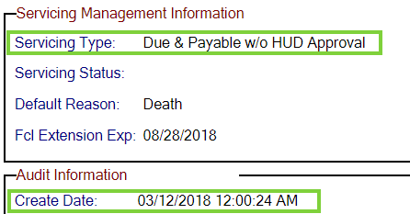
#13 – Auto Curtailment – Notify Borrower of D&P Event
Notification to Borrower of D&P for D&P w/o HUD Approval
For loans with a D&P Due Date on or after 7/1/15, (Effective Date of ML 2015-10), Notification to Borrower of D&P must be within 30 days of Notifying HUD of Default.
For D&P w/o HUD Approval, HERMIT will “auto-curtail” Claim Type 21 or Claim Type 23 if Notification Sent to Borrower step is not completed within 30 days of the D&P w/o HUD Approval timeline setup/Create Date.
If curtailed for this reason, HERMIT will set the Debenture Interest End Date to D&P w/o HUD Approval timeline Create Date + 30 Days.
NOTE: “Notification to Borrower” event can occur before “Notification to HUD” event meaning the claim will not be curtailed for the letter being sent to borrower “early”.
Example: This loan will be “auto-curtailed” because the “D&P Notice Sent to Borrower” was not completed 30 days from the notification to HUD (the D&P w/o HUD Approval timeline “Create Date).
Reference: Mortgagee Letter 2015-10 and CFR Reference § 206.125(a)(2).

Slide 32
#14 – Auto Curtailment – Initiation of FCL (First Legal) Event
First Legal curtailment for D&P with HUD Approval and FHA Case # assigned before 9/19/17.
For FHA Case # Assigned Date before 9/19/17 and D&P with HUD Approval, the initiation of FCL (First Legal step completed) or a Deed in Lieu (DIL) must be completed within 6 months of borrower notification of D&P.
Specifically, Claim Type 21 will “auto-curtail” if the Loss Mitigation - Pre-Foreclosure timeline Initiation of Foreclosure (First Legal) step Complete Date (or DIL Completion Date entered in the claim Disposition page) is not <= later of:
The D&P Notice Sent to Borrower step Complete Date + 6 Months OR
Exp. Date of Approved Ext (1st Legal to Commence FCL / Deed in Lieu) on the claims Disposition page: (Block #19)
If claim is curtailed for this reason, the Debenture Interest End Date will be set to the D&P Notice Sent to Borrower step Complete Date + 6 Months OR Ext Expiration Date, whichever is greater.
Example: This loan will be “auto-curtailed” because the Initiation of Foreclosure (First Legal Date) was not completed within 6 months of the D&P Notice Sent to Borrower.
Reference: Mortgagee Letter 2015-10 and CFR Reference § 206.125(d)(1).

Slide 33
#15 – Auto Curtailment – Initiation of FCL (First Legal) Event
First Legal curtailment for D&P w/o HUD Approval: Death and FHA Case # assigned date before 9/19/17
For FHA Case # Assigned Date before 9/19/17 and D&P w/o HUD Approval, the initiation of FCL (First Legal) or a Deed in Lieu (DIL) must be completed within 6 months of the DEATH DATE.
Specifically, Claim Type 21 will “auto-curtail” the Loss Mitigation – Pre-Foreclosure timeline Initiation of Foreclosure (First Legal) step Complete Date (or DIL Completion Date entered in the claim disposition page) is not <= later of:
DEATH DATE + 6 Months OR
Exp. Date of Approved Ext (1st Legal to Commence FCL / Deed in Lieu) in the claims disposition page (Block #19)
If claim is curtailed for this reason, the Debenture Interest End Date will be set to the DEATH Date + 6 Months OR Ext Expiration Date, whichever is greater.
Example: This loan will be “auto-curtailed” because the Initiation of Foreclosure (First Legal Date) was not completed within 6 months of the Death Date. (This example “auto curtails” on 1/17/2017).
Reference: Mortgagee Letter 2015-10 and CFR Reference § 206.125(d)(1).

Slide 34
#16 – Auto Curtailment – Initiation of FCL (First Legal) Event
First Legal curtailment for D&P w/o HUD Approval: Conveyed Title and FHA Case # assigned date before 9/19/17
For FHA Case # Assigned Date before 9/19/17 and D&P w/o HUD Approval, the initiation of FCL (First Legal) or a Deed in Lieu (DIL) must be completed within 6 months of the Notification Sent to Borrower for Default Event Conveyed Title.
Specifically, Claim Type 21 will “auto curtail” if the Loss Mitigation – Pre-Foreclosure timeline Initiation of Foreclosure (First Legal) step Complete Date (or DIL Completion Date entered of the claim Disposition page) is not <= later of:
Notification Sent to Borrower Step + 6 Months OR
Exp. Date of Approved Ext (1st Legal to Commence FCL / Deed in Lieu) on the claims Disposition page (Block #19)
If claim is curtailed for this reason, the Debenture Interest End Date will be set to the D&P Notice Sent to Borrower step Complete Date + 6 Months OR Ext Expiration Date, whichever is greater.
Example: This loan will be “auto-curtailed” because the Initiation of Foreclosure (First Legal Date) was not completed within 6 months of Notification Sent to Borrower step.
CFR reference: Mortgagee Letter 2015-10

Slide 35
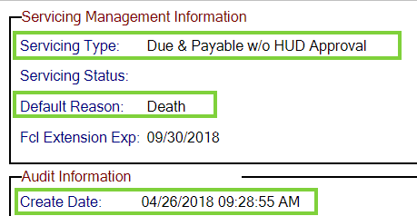
#17 – Auto Curtailment – Initiation of FCL (First Legal) Event
First Legal curtailment for D&P with or w/o HUD Approval and FHA Case # Assigned Date on or after 9/19/17. (Same logic with or w/o HUD Approval)
For FHA Case # Assigned Date on or after 9/19/17 and D&P with or w/o HUD Approval, the initiation of FCL (First Legal) or a Deed in Lieu (DIL) must be completed within 6 months of the DUE DATE.
Specifically, Claim Type 21 will “auto-curtail” the Loss Mitigation – Pre-Foreclosure timeline Initiation of Foreclosure (First Legal) step Complete Date (or DIL Completion Date entered on the claim Disposition page) is not <= later of:
DUE DATE + 6 Months OR
Exp. Date of Approved Ext (1st Legal to Commence FCL / Deed in Lieu) in the claims Disposition page (Block #19)
If claim is curtailed for this reason, the Debenture Interest End Date will be set to the DUE DATE + 6 Months OR Ext Expiration Date, whichever is greater.
Example: This loan will be “auto-curtailed” because the Initiation of Foreclosure (First Legal Date) was not completed within 6 months of DUE DATE.
CFR reference: Mortgagee Letter 2015-10

Slide 36
#18 – Auto Curtailment – Notify HUD of First Legal Action Event
Notification to HUD of First Legal must be within 30 days of Initiation of First Legal
For loans with a D&P Due Date on or after 7/1/15, (Effective Date of ML 2015-10), HUD must be notified of First Legal date within 30 days.
Specifically, HERMIT will “auto-curtail” on a Claim Type 21 if Foreclosure Notice Sent to HUD step Complete Date from the Disposition: Loss Mitigation – Pre-Foreclosure timeline is not completed within 30 days of Initiation of Foreclosure (First Legal Date) step Complete Date from the Loss Mitigation – Pre-Foreclosure timeline.
If claim is curtailed for this reason, the Debenture Interest End Date will be set to the Initiation of Foreclosure (First Legal Date) step Complete Date + 30 Days.
The logic for Notification to HUD of First Legal is the same for both D&P with or D&P w/o HUD Approval.
Example: This loan will be “auto-curtailed” because the Foreclosure Notice Sent to HUD was not completed within 30 Days of Initiation of Foreclosure (First Legal Date)
CFR reference: Mortgagee Letter 2015-10

Slide 37
#19 – Auto Curtailment – Foreclosure Sale Appraisal Event
Foreclosure Sale Appraisal must be completed 30 days prior to “Foreclosure Sale” date
For FHA Case # Assigned Date on or after 9/19/17, the Foreclosure Sale Appraisal must be completed 30 days prior to the “Foreclosure Sale”.
HERMIT will “auto-curtail” a Foreclosure Claim Type 21 only if Foreclosure Sale Appraisal Date (optional step) step Complete Date from the Foreclosure timeline is not completed within 30 days prior to the Foreclosure Sale Date step Complete Date also from the Foreclosure timeline.
If claim is curtailed for this reason, the Debenture Interest End Date will be set to the Foreclosure Sale Date step Complete Date.
The logic for Foreclosure Sale Appraisal is the same for both D&P with or D&P w/o HUD Approval.
Example: This loan will be “auto-curtailed” because the Foreclosure Sale Appraisal step was not completed within 30 Days prior to Foreclosure Sale Date step completion.
Reference Mortgagee Letter 2015-10 and CFR Reference § 206.125(b).

Slide 38
#20 – Auto Curtailment – Claim Filing Deadline
Change number of days for Claim Filing Curtailment from 15 days to 30 days
Claim filing deadline depends on FHA Case # Assigned Date:
Before 9/19/17, the claim must be filed within 15 days
On or after 9/19/17, the claim must be filed within 30 days
HERMIT will “auto-curtail” Claim Type 21 or Claim Type 23 if:
FHA Case # Assigned Date before 9/19/17: Servicer Files Claim 27011 step Complete Date is not within 15 days of the date in Block #10
FHA Case # Assigned Date on or after 9/19/17: Servicer Files Claim 27011 step Complete Date is not within 30 days of the date in Block #10
If claim is curtailed for this reason, the Debenture Interest End Date will be set to Block #10 + 15 Days, or 30 days, respectively.
CFR reference: CFR section § 206.127 Application for Insurance Benefits. (Page 7136)

Slide 39
Wrap Up – HERMIT Resource Page
The HERMIT Resource Page
https://www.hud.gov/program_offices/housing/comp/hecm_hermit
Recommended Resources:
HERMIT System Changes – Release 5.4 to Release 5.71
Claim Mapping (includes CT24)
Claims Submission Checklist
This PowerPoint Webinar Slides will be posted to the HERMIT resource page
Please send any questions to Theresa Coffman @ Theresa.J.Coffman@hud.gov

